Slide 1
Indian Currency Recognition
Under the Guidance of
PROF. SUBHASHIS CHATTERJEE
Presented by
Chinmay Sathe | 19MT0119

Slide 2
A Little Recap…
Thesis Objective :

Slide 3
A Little Recap…
Thesis Objective :
Create an object detection model,

Slide 4
A Little Recap…
Thesis Objective :
Create an object detection model,
which would detect Indian Currency notes,

Slide 5
A Little Recap…
Thesis Objective :
Create an object detection model,
which would detect Indian Currency notes,
which later can be used by visually impaired people.

Slide 6
A Little Recap…
Part 1. Literature Review
Nijil Raj N, Anandu S Ram, Aneeta Binoo Joseph, Shabna S
Part 2. Data Collection
Collection of data from various sources
Adding some data from my side
Kushal Bhavsar , Keyurbhai Jani , and Rakeshkumar Vanzara
Part 3. Data Preparation
Label Images
Data Augmentation
Qian Zhang

Slide 7
Project Work Flow
Collect Data from Various Sources
Data Augmentation
Training CNN Model
Currency Recognition
Adding YOLO/Tiny-YOLO
Currency Detection
Data Annotation

Slide 8
Collecting the Data
Collected nearly 500+ images of each denomination, of which 45 were used as validation, rest were for training purposes.
30% from Kaggle, rest 70% was either captured or scrapped from google.
The images varied from 150x150 to 4000x4000 in pixel sizes & from 5 KB to around 4000 KB in file sizes.
The reason for collecting such variety of image was to bring robustness to the model.
Background images, were not used, since they created a degradation in model performance.

Slide 9
Directory View
DATA
Validate
10
20
50
100
200
500
2000

Slide 10
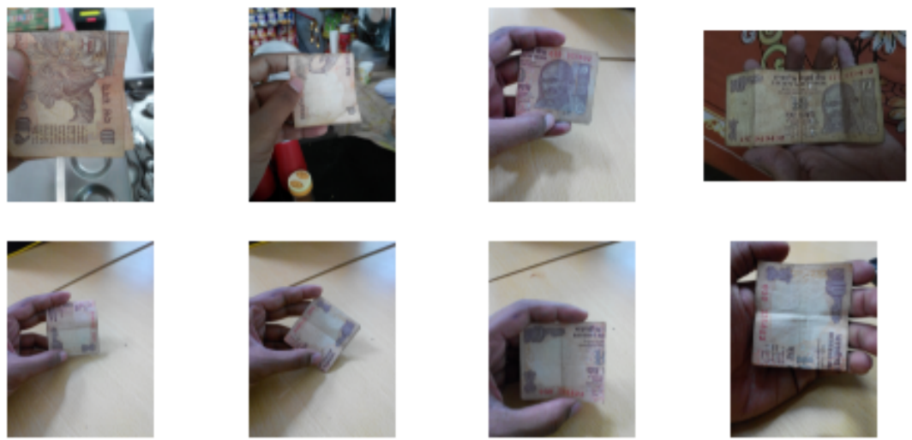
Some Samples:

Slide 11
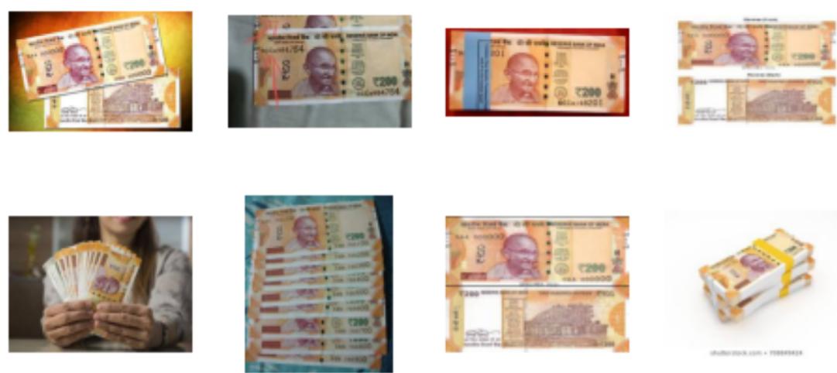
Some Samples:

Slide 12
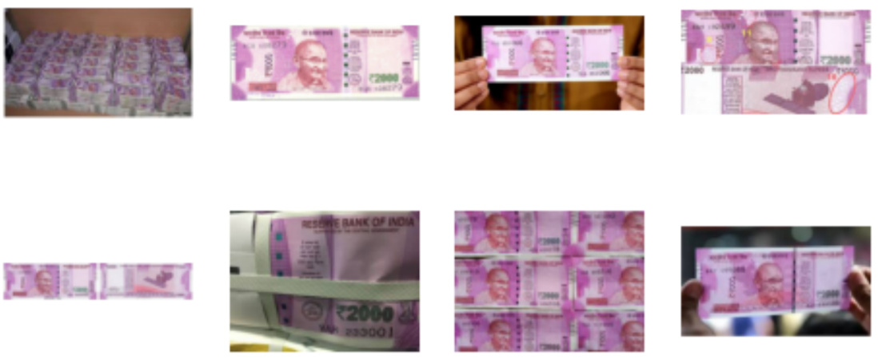
Some Samples:

Slide 13
Project Work Flow
Collect Data from Various Sources
Data Augmentation
Training CNN Model
Currency Recognition
Adding YOLO/Tiny-YOLO
Currency Detection
Data Annotation

Slide 14
Project Work Flow
Collect Data from Various Sources
Data Augmentation
Training CNN Model
Currency Recognition
Adding YOLO/Tiny-YOLO
Currency Detection
Data Annotation

Slide 15
Data Augmentation
Since, I had a total of 3500+ images already, I assumed model would not require any more training data.
Hence, I deferred from using data augmentation here, as proposed in the earlier part.
Later, in the results it showed that the decision was correct.
Although, I did normalize the images to be in the range [0,1], to ensure each image has same distribution.

Slide 16
Project Work Flow
Collect Data from Various Sources
Data Augmentation
Training CNN Model
Currency Recognition
Adding YOLO/Tiny-YOLO
Currency Detection
Data Annotation

Slide 17
Project Work Flow
Collect Data from Various Sources
Data Augmentation
Training CNN Model
Currency Recognition
Adding YOLO/Tiny-YOLO
Currency Detection
Data Annotation

Slide 18
Training CNN
I tried few hit and trial architectures, trained them for around 10 epochs and compared those results.
After a lot of experimentation, I was able to get good results from some of them.
I chose one that was training quickly and gave comparatively better accuracy.
It is a 6 layered model, with 2 dropout layers as well.

Slide 19
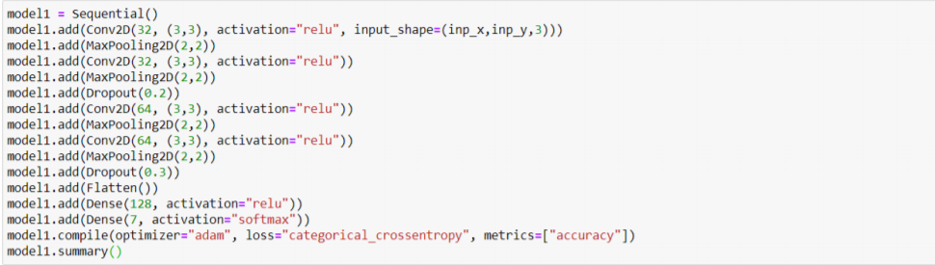
Training CNN

Slide 20
Training CNN

Slide 21
Training CNN

Slide 22
Training CNN

Slide 23
Training CNN
Trained two types of model of the same architecture, just to see if I would better results.
One had input size of 150x150 and the other 224x224. These are the standard sized inputs. All in RGB colour coding.
Early stopping and Model check points were used in both.

Slide 24
Project Work Flow
Collect Data from Various Sources
Data Augmentation
Training CNN Model
Currency Recognition
Adding YOLO/Tiny-YOLO
Currency Detection
Data Annotation

Slide 25
Project Work Flow
Collect Data from Various Sources
Data Augmentation
Training CNN Model
Currency Recognition
Adding YOLO/Tiny-YOLO
Currency Detection
Data Annotation

Slide 26
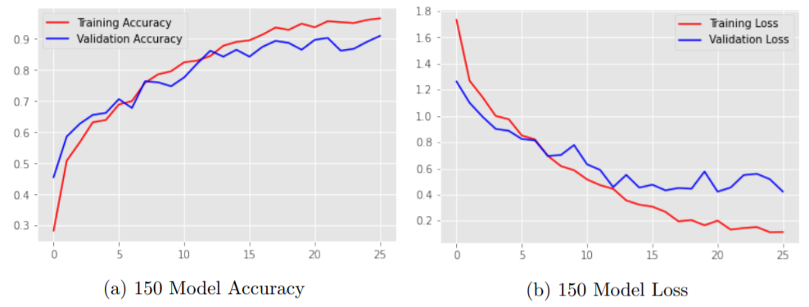
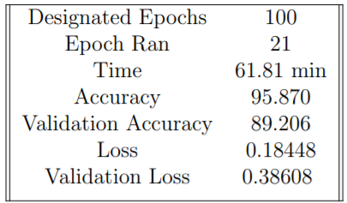
Currency Recognition
150x150 Model
224x224 Model

Slide 27
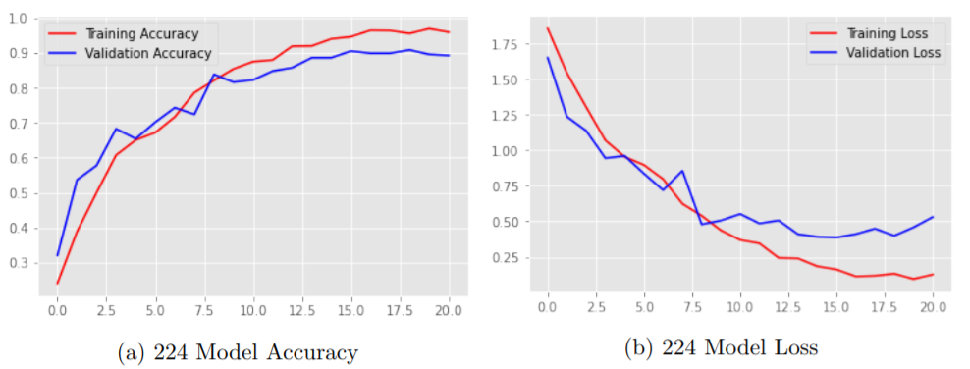
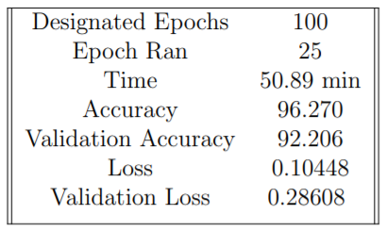
Currency Recognition
150x150 Model
224x224 Model

Slide 28
Currency Recognition
150x150 Model
224x224 Model

Slide 29
Project Work Flow
Collect Data from Various Sources
Data Augmentation
Training CNN Model
Currency Recognition
Adding YOLO/Tiny-YOLO
Currency Detection
Data Annotation

Slide 30
Project Work Flow
Collect Data from Various Sources
Data Augmentation
Training CNN Model
Currency Recognition
Adding YOLO/Tiny-YOLO
Currency Detection
Data Annotation

Slide 31
What is Data Annotation?

Slide 32
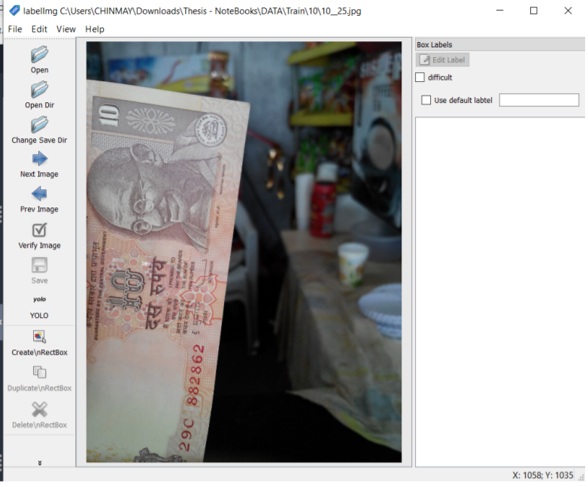
Using LabelIMG tool

Slide 33
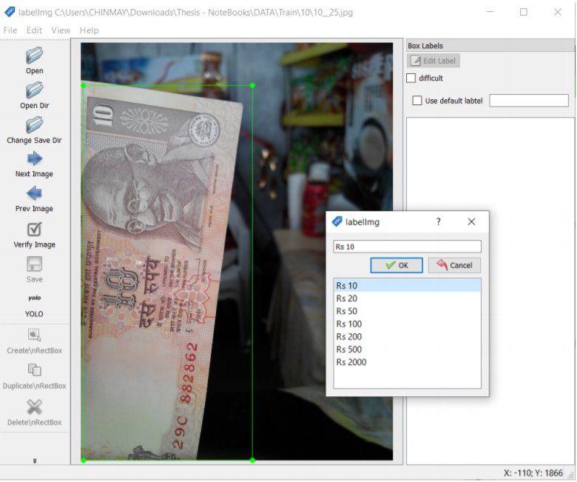
Using LabelIMG tool

Slide 34
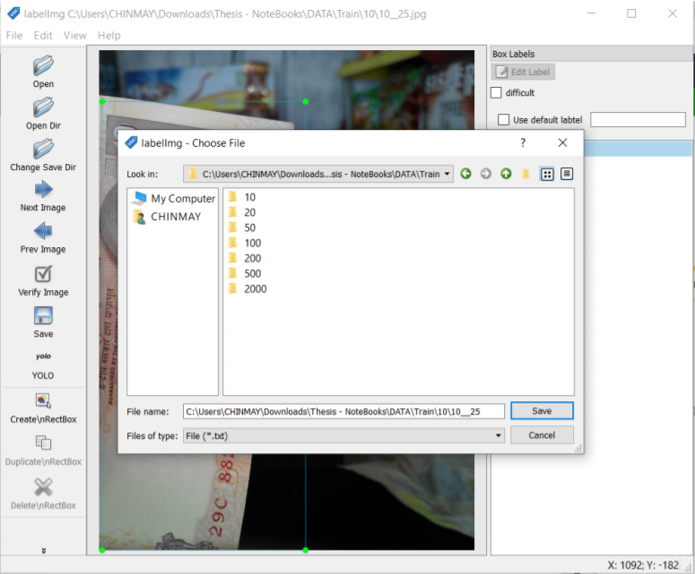
Using LabelIMG tool

Slide 35
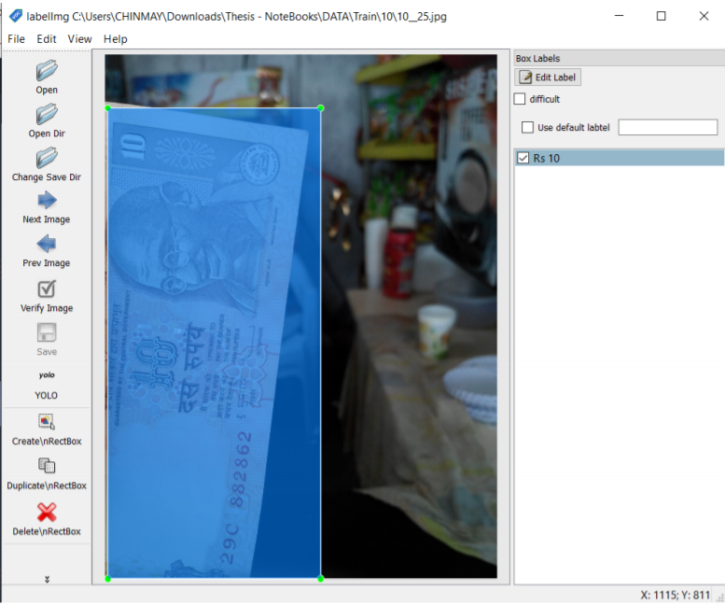
Using LabelIMG tool

Slide 36
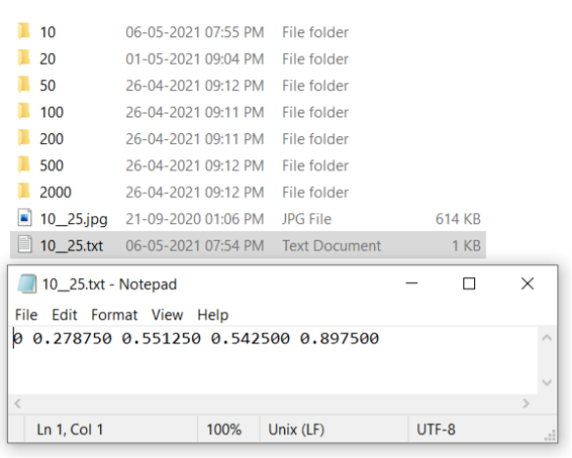
Using LabelIMG tool

Slide 37
Project Work Flow
Collect Data from Various Sources
Data Augmentation
Training CNN Model
Currency Recognition
Adding YOLO/Tiny-YOLO
Currency Detection
Data Annotation

Slide 38
Project Work Flow
Collect Data from Various Sources
Data Augmentation
Training CNN Model
Currency Recognition
Adding YOLO/Tiny-YOLO
Currency Detection
Data Annotation

Slide 39
YOLO
YOLO or You Only Look Once are real time object detection models, which basically works on extracted features from any CNN model.

Slide 40
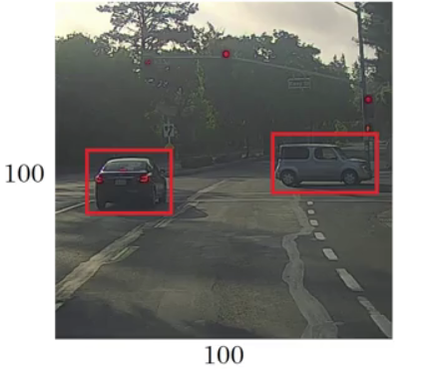
YOLO
YOLO or You Only Look Once are real time object detection models, which basically works on extracted features from any CNN model.
Step 1 ->

Slide 41
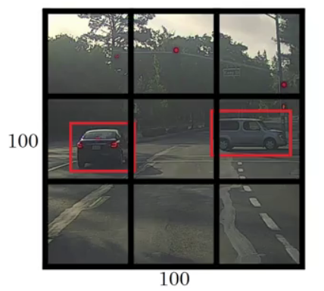
YOLO
YOLO or You Only Live Once are real time object detection models, which basically works on extracted features from any CNN model.
Step 2 ->

Slide 42
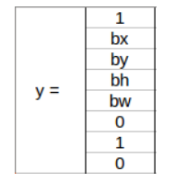
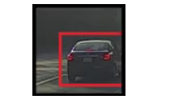
YOLO
YOLO or You Only Live Once are real time object detection models, which basically works on extracted features from any CNN model.
Step 3 ->

Slide 43
YOLO
YOLO or You Only Live Once are real time object detection models, which basically works on extracted features from any CNN model.
Step 3 ->

Slide 44
YOLO
YOLO or You Only Live Once are real time object detection models, which basically works on extracted features from any CNN model.
Step 3 ->

Slide 45
YOLO
YOLO or You Only Live Once are real time object detection models, which basically works on extracted features from any CNN model.
Step 3 ->

Slide 46
Intersection over Union
Intersection over Union is simply an evaluation metric. Any algorithm that provides predicted bounding boxes as output can be evaluated using IoU.
The two types of boxes :
The ground-truth bounding boxes (i.e., the hand labeled bounding boxes from the testing set that specify where in the image our object is).
The predicted bounding boxes from our model.

Slide 47
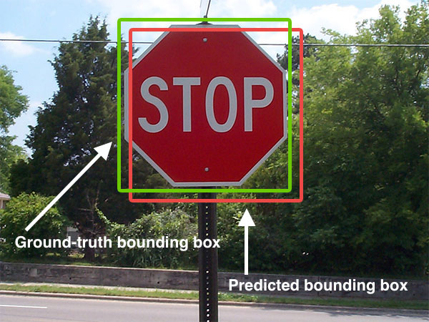
Intersection over Union

Slide 48
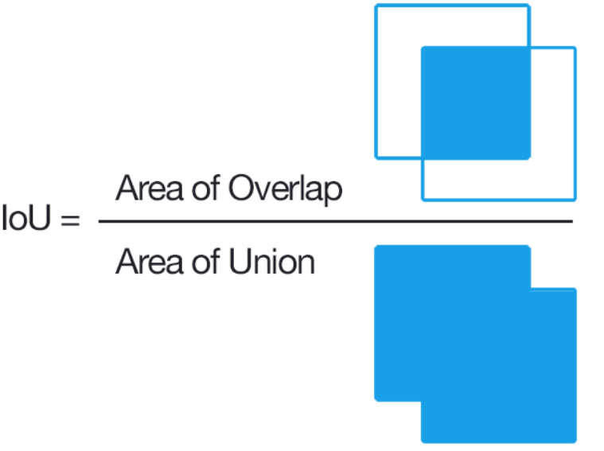
Intersection over Union

Slide 49
Some more on YOLO
Input Image -> SxS grids. If the center of the object falls in any grid cell, that grid cell is responsible for detecting the object.
Each grid predicts the no. of bounding boxes and confidence scores of those boxes.
Confidence = Prob(Object) x threshold IoU score (generally 0.5>)
Bounding Box = x,y: Center of the box; w,h: Height & width of the box

Slide 50
Some more on YOLO
Then,
Prob(Class/Object) = Conditional Class Probabilty
Prob(Object) x IoU = Individual Box Confidence
Multiplying 1. & 2., we get,
Prob(Class) x IoU = Class specific confidence score of each box.

Slide 51
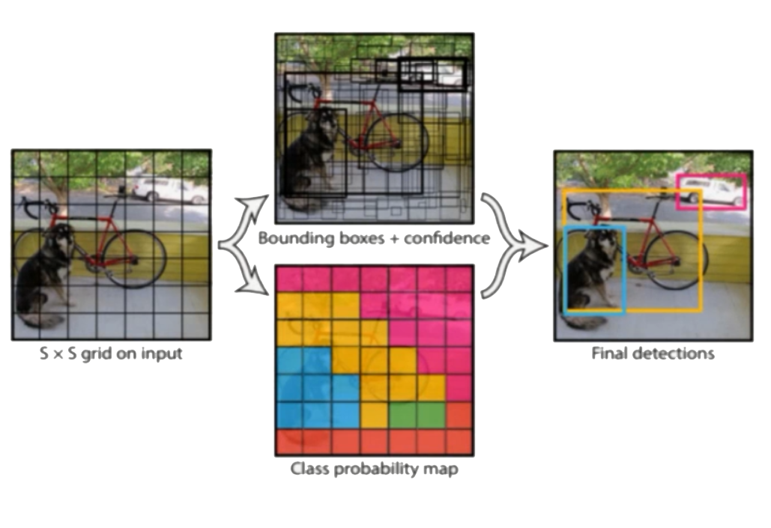
Some more on YOLO

Slide 52
YOLO or Tiny-YOLO
YOLO although very fast, still took around 6-7 hours to be fully trained for just 70 images of training data set.
Thus, it was practically impossible for the complete data set to be used.
Tiny-YOLO is 442 times faster and much smaller brother of YOLO model.
Unfortunately, it also causes the accuracy to be lower than any other model.
But, given that other model take 1000x time, it is better to use Tiny-YOLO whenever high accuracy is not demanded.

Slide 53
Project Work Flow
Collect Data from Various Sources
Data Augmentation
Training CNN Model
Currency Recognition
Adding YOLO/Tiny-YOLO
Currency Detection
Data Annotation

Slide 54
Project Work Flow
Collect Data from Various Sources
Data Augmentation
Training CNN Model
Currency Recognition
Adding YOLO/Tiny-YOLO
Currency Detection
Data Annotation

Slide 55
Currency Detection
The tiny-YOLO model secured an accuracy of 99.34% along as well as training loss of 0.3675.
While YOLO was taking impractical time, thus that approach was not continued further

Slide 56
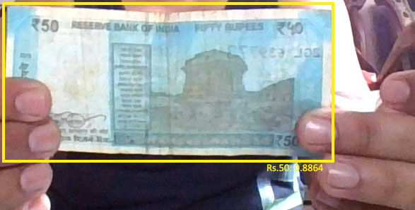
Currency Detection

Slide 57
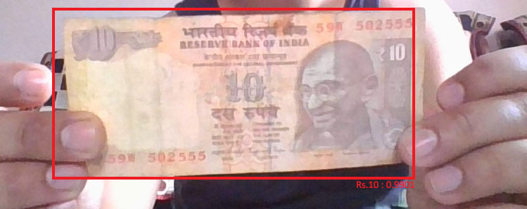
Currency Detection

Slide 58
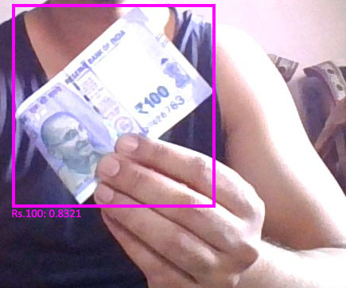
Currency Detection

Slide 59
Project Work Flow
Collect Data from Various Sources
Data Augmentation
Training CNN Model
Currency Recognition
Adding YOLO/Tiny-YOLO
Currency Detection
Data Annotation

Slide 60
Project Work Flow
Collect Data from Various Sources
Data Augmentation
Training CNN Model
Currency Recognition
Adding YOLO/Tiny-YOLO
Currency Detection
Data Annotation

Slide 61
Future Work
In future, if the computational advancements allow, complete or at the very least 50% of data could be used.
CNN Model can be further trained with different sets of parameters that include number of hidden layers as well. The input can be varied for faster computation as well.
The trained model from the final Tiny-YOLOs result can be used in developing a mobile or computer application, which can be used by people for easily detecting Indian currency.

Slide 62
References
Deep Learning Based Indian Currency Detection for Visually Challenged using VGG16 - Nijil Raj N, Anandu S Ram, Aneeta Binoo Joseph, Shabna S, (International Journal of Recent Technology and Engineering (IJRTE) ISSN: 2277-3878, Volume-9 Issue-2, July 2020 969 Published By: Blue Eyes Intelligence Engineering & Sciences Publication Retrieval Number: B3955079220/2020©BEIESP DOI:10.35940/ijrte.B3955.079220 )
Indian Currency Recognition from Live Video Using Deep Learning - Kushal Bhavsar, Keyurbhai Jani , and Rakeshkumar Vanzara (U. V. Patel College of Engineering, Ganpat University, Mehsana 384012, Gujarat, India)
Indian Currency Recognition using Neural Network Pattern Recognition Tool - Mr.Viranchi N Patel1, Dr.Udesang K Jaliya2 and Mr.Keyur N Brahmbhatt (BVM Engineering College, V.V.Nagar, India )
Currency Recognition Using Deep Learning - Zhang Qian,Yan, Weiqi (Auckland University of Technology, Master of Computer and Information Sciences,2018-11-18T03:45:35Z)

Slide 63
Thank You

